Slide 1
Jira- Training
Created by: Thuong Pham

Slide 2

Table of content
Introduction
Overview
Main menu
Defect management

Slide 3
I. Introduction

Slide 4
1.1.What will you learn
Jira is a tool, developed by Atlassian, which provides bug tracking, issue tracking, and project management functions.
Using this tool will provide a clear overview for all open issues, the status and progress of those open issues, as well as provide transparency to all teams - including GMC, SDS, Accenture Interactive (AI), Subsidiary teams (Sub).

Slide 5
1.2.What Jira Can Do For You
Jira is a bug-tracking system used by AI to monitor the progress of code changes and bug fixes, as well as to manage the QA process. Utilizing this tool will improve your overall day-today experience in managing projects and tasks, as well as provide an opportunity to have better communication with the teams you’re working with.
We encourage all communication regarding an open issue (or ticket) be included within the ticket itself so the ticket tracks the entire history of the issue from creation to completion. This method of avoiding mixed communication in emails will give everyone the ability to look up the latest status of any issue (or ticket) at any given time in Jira without having a dependency on another person to receive that update, providing transparency at all times and to all team members.

Slide 6
1.3. Using Jira systems
AI JIRA:
https://alm.accenture.com/jira/projects/SAMT/issues/SAMT-22726?filter=allopenissues
+Confluence (wiki) : Collaboration space used for sharing documentation (e.g. meeting minutes, specifications) and functional and technical requirements.
+Jira: Document stories, defects, tasks and open questions.
Samsung JIRA (Samsung internal Jira) Document stories, defects, tasks and open questions
https://jira.shop.samsung.com:8443/secure/Dashboard.jspa

Slide 7
II. Overview

Slide 8
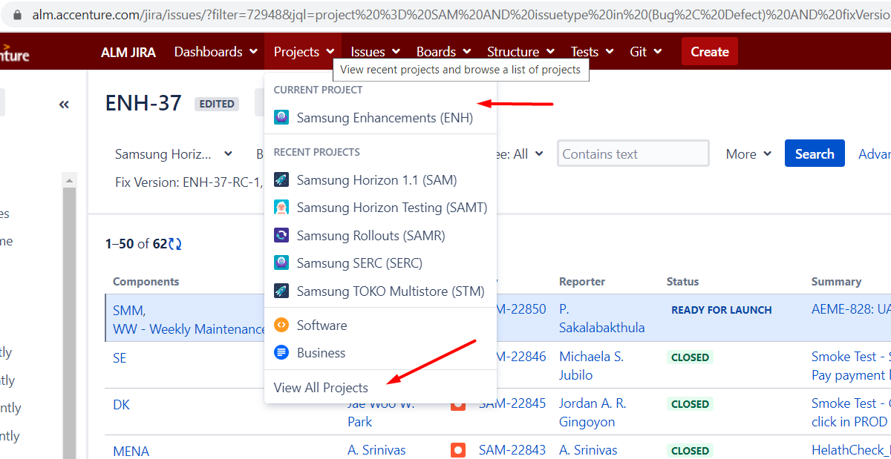
1. Projects

Slide 9
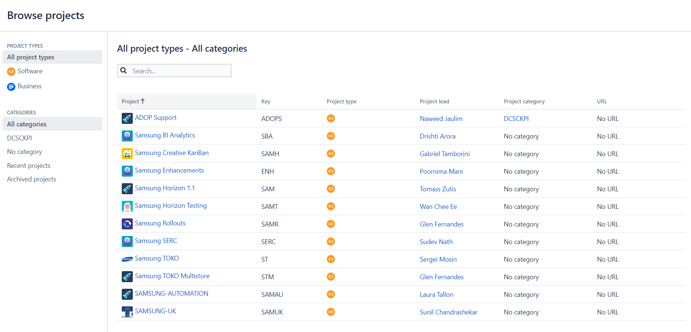
1. Projects

Slide 10
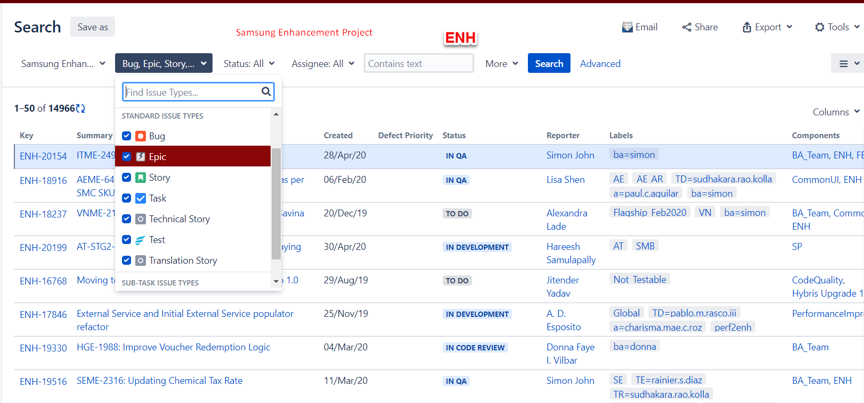
1.1. Project- ENH

Slide 11
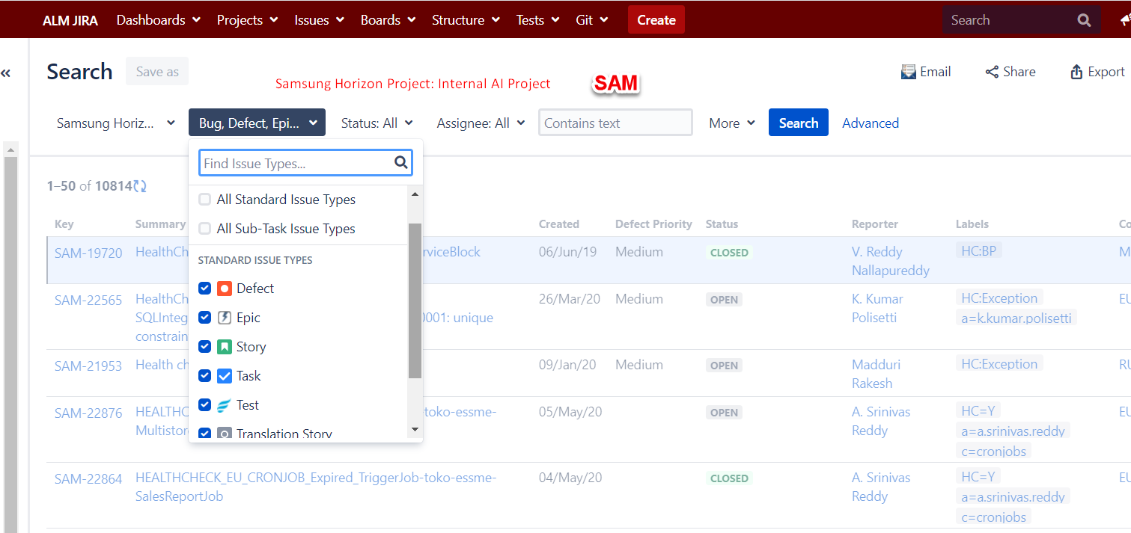
1.1. Project- SAM

Slide 12
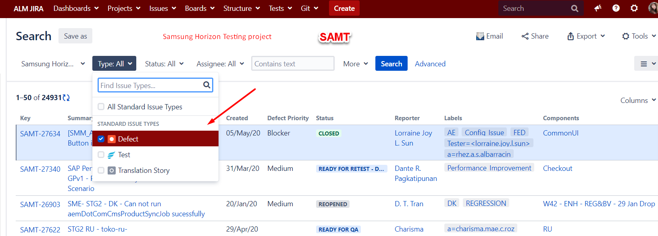
2. Types of issues
Project | JIRA Ticket Issue Type | Definition | When It Should Be Used | Examples
Samsung Horizon Testing | Defect | Defect found while testing Samsung project. It may be logged by WW or AI team. | To manage defect logged during regression testing (monthly/maintenance) To track defect’s status: WW’s reporters need to retest if the defect’s status is Ready for retest. | SAMT-27629 SAM2-STG2-BO-VN: Cronjob vn-bulkFetchConsignmentUpdateJob is not working

Slide 13
2. Types of issues
Project | JIRA Type | Definition | When It Should Be Used | Examples
Samsung Enhancements/ Samsung Horizon | Epic | Large piece of work that encompasses many issues | To keep track of large scope of work that can not be resolved in 1 ticket | ENH-19142 PHME-123 Portugal Paypal Integration
Samsung Enhancements/ Samsung Horizon | Story | Functionality request expressed from the perspective of the user | To make it clearer from user perspective. Usually have sections: CONTEXT ACCEPTANCE CRITERIA TECHNICAL CONSIDERATIONS | ENH-20154 ITME-2497: SEI - New filters for TV on Shop ENH-18237 VNME-2174: Make Google Maps component for Savina
Samsung Enhancements/ Samsung Horizon | Task | Task that needs to be done | To manage team’s task. It may be listed under an Epic | ENH-20104 Support NZ for EPP setup
Samsung Enhancements/ Samsung Horizon | Technical story |  | Relate to technical | ENH-14550 MYME-220 Send Trade-In report to the business
Samsung Enhancements/ Samsung Horizon | Test |  | For AI’s tester Usually links to a Story/task | ENH-20050 ENH-19516: Verify that Tax rate is 0 when chemical tax rate is greater than 0 AND new tax rate is equal to 0.
Samsung Enhancements/ Samsung Horizon | Bug | Bug found during testing |  | ENH-20200 AT-STG2-AT SMB Cart page Header to return to the home translation is not updated
Samsung Enhancements/ Samsung Horizon | Translation story | Relate to Translation |  | ENH-7266 SP-282 SMB Translations

Slide 14
III. Main menu

Slide 15
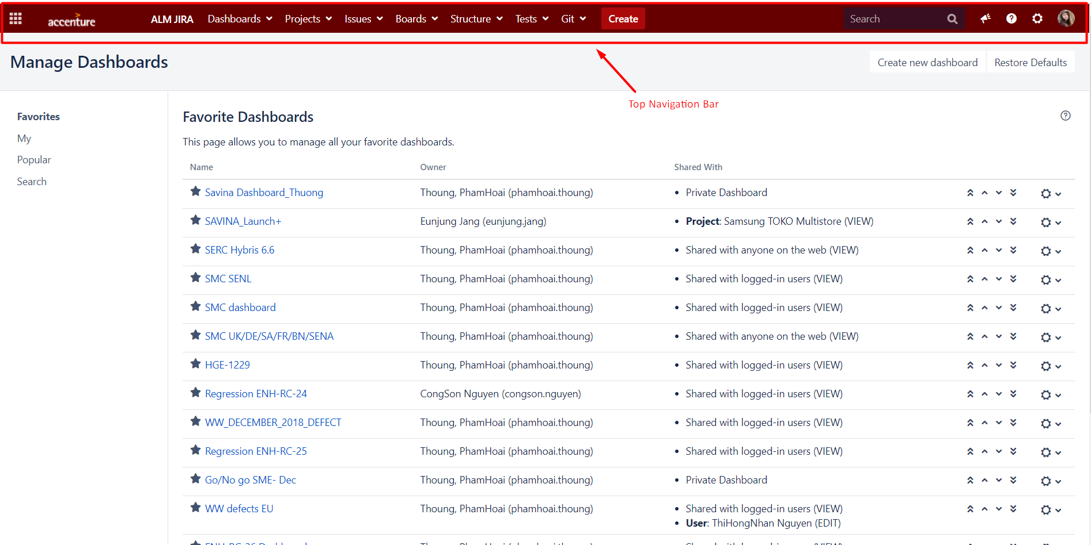
1. Top Navigation bar

Slide 16
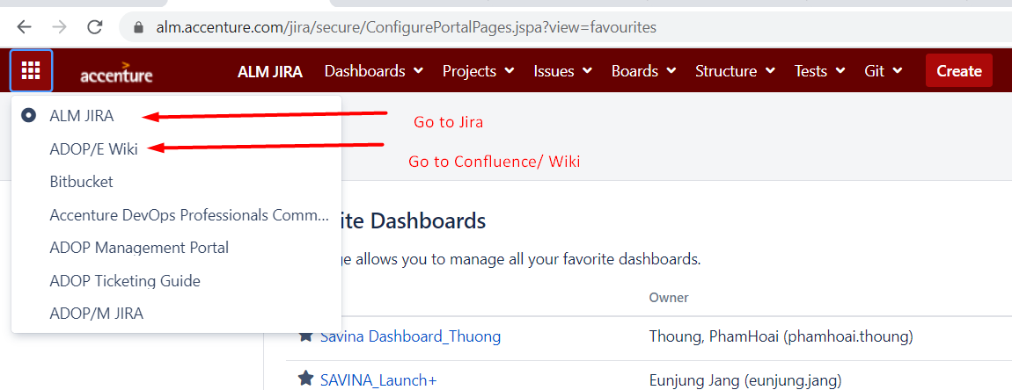
2. Menu (9-dot drop down)

Slide 17
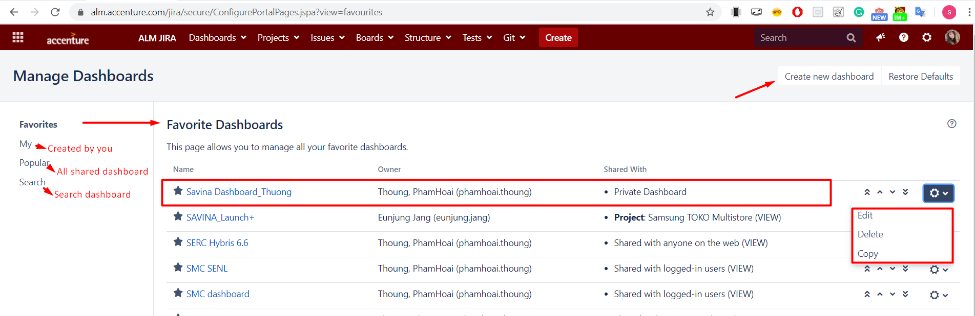
3. Dashboard
View System Dashboard: This will load the main dashboard page that you see when you first log into Jira.
Manage Dashboard: You have the ability to manage all of your dashboards.

Slide 18
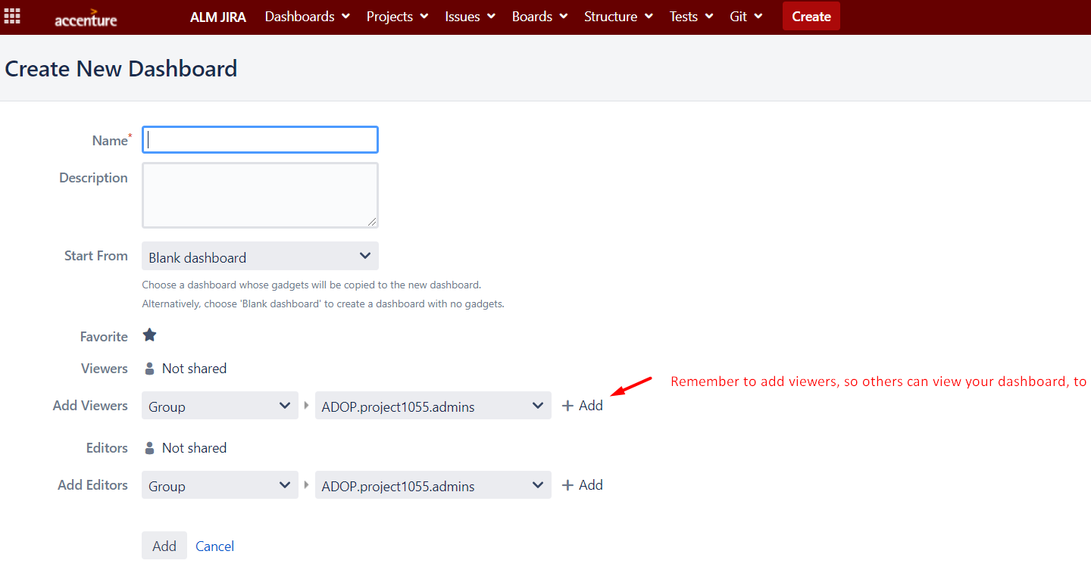
3. Dashboard-Create
You can create Dashboard by Click Create new dashboard or Copy from existing one

Slide 19
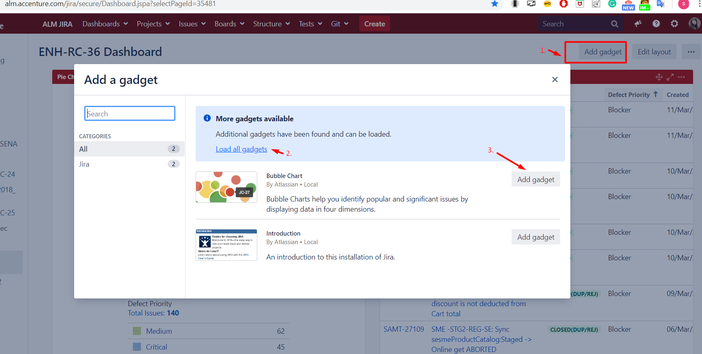
3. Dashboard-Create
Add gadget that support to your report to your Dashboard

Slide 20
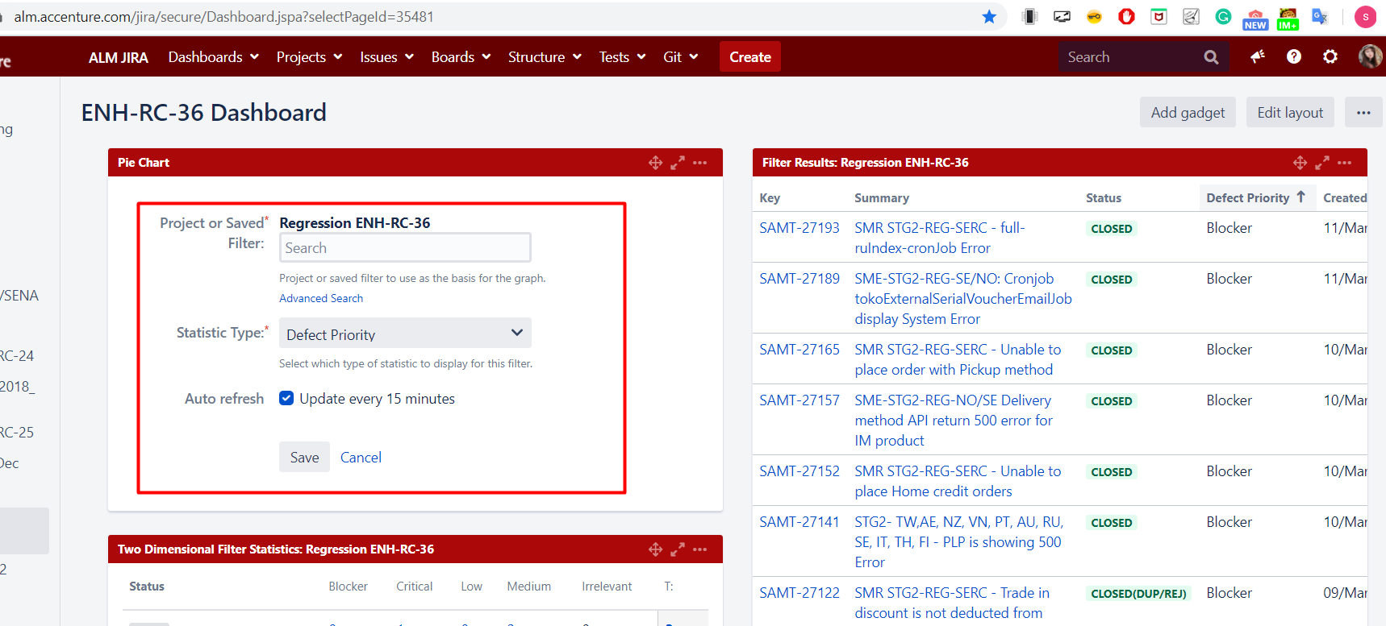
3. Dashboard-Create
Edit gadget
Note: If this gadget uses filter, pls make sure your filter is shared with others, too

Slide 21
4. Project

Slide 22
4. Project
SAMT: Samsung Horizon Testing: Testing project. WW logs/tracks defect in this project
SAM: Samsung Horizon 1.1: AI internal project
ENH: Samsung Enhancement: Enhancement raised by Samsung subsidiaries will be linked to this project. Then AI breaks down into tasks to get it done.
SAMR: Samsung Rollouts: Manage new countries roll out’s tasks/defects.
View All Projects: This page will list all of the projects you’re assigned to, where you can click through to each one individually to view the project’s Activity Stream and other project details.
In Samsung Jira
RT: Regression project
EMBT: Enhancement BVT
HSEO: Spoke project
Maintenance project

Slide 23
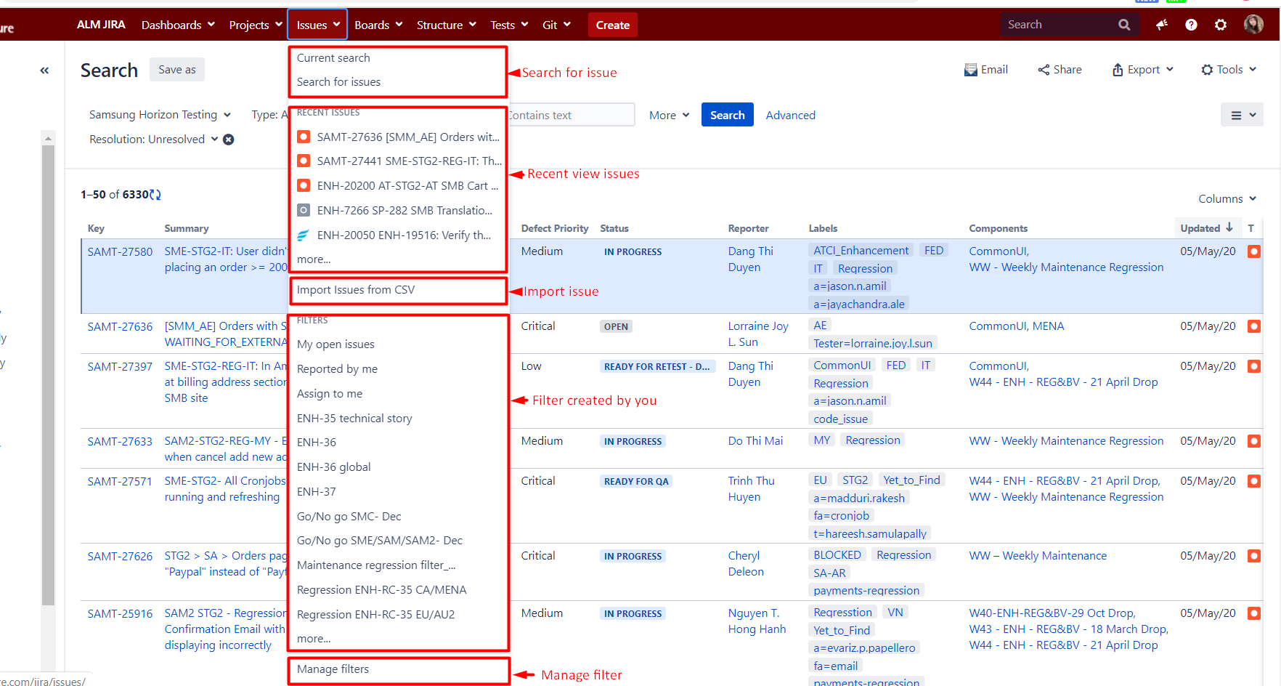
5. Issues
The “Issues” button found in the header shows multiple options, allowing you to search within all open tickets, showing recent tickets that have been created, and saved filters

Slide 24
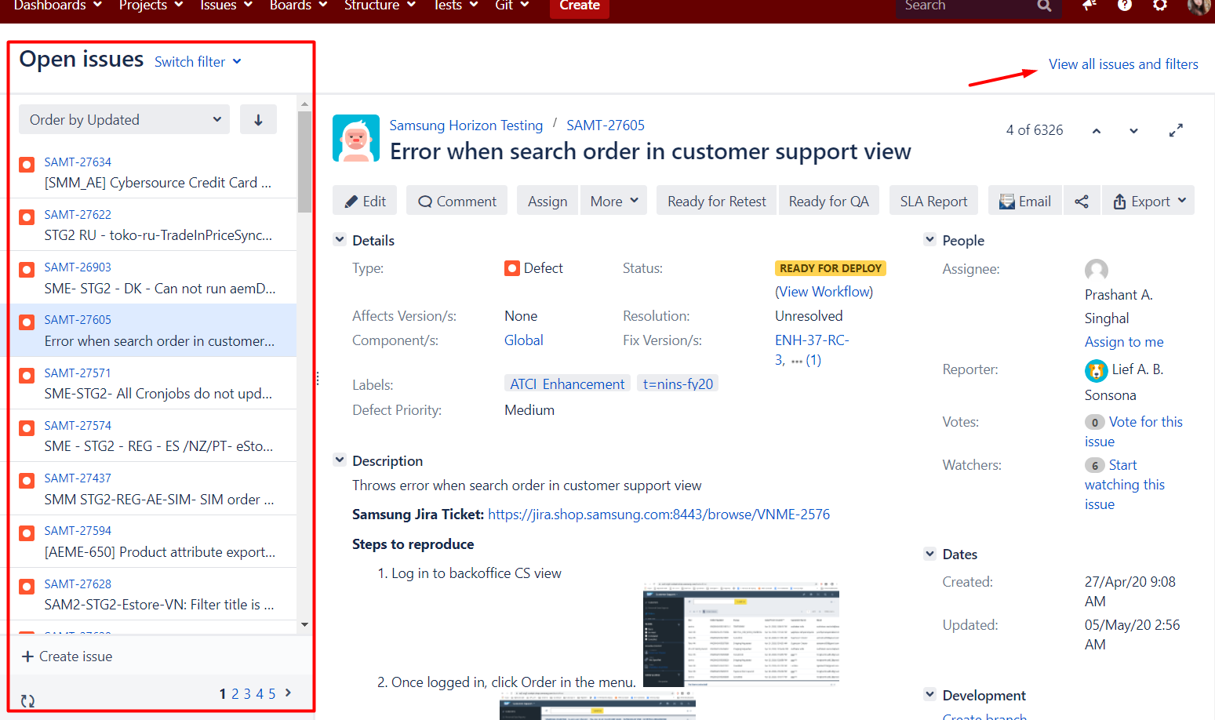
5.1. Search Issues

Slide 25
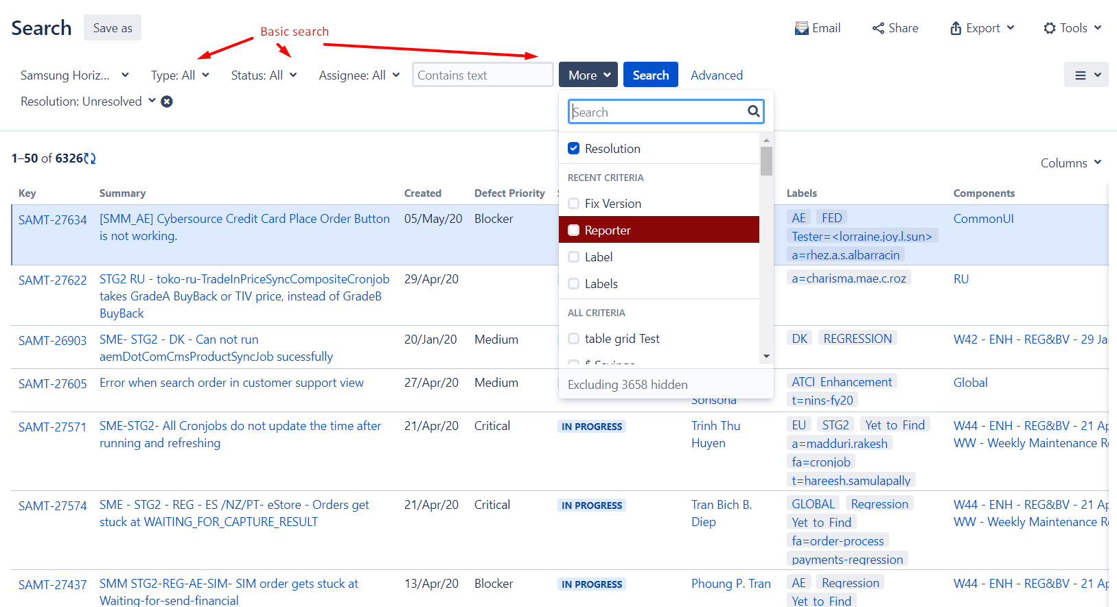
5.1. Search Issues- Basic search

Slide 26
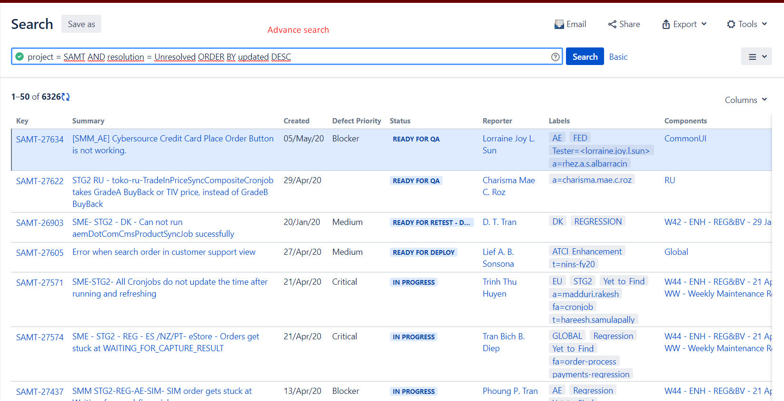
5.1. Search issues- Advance search

Slide 27
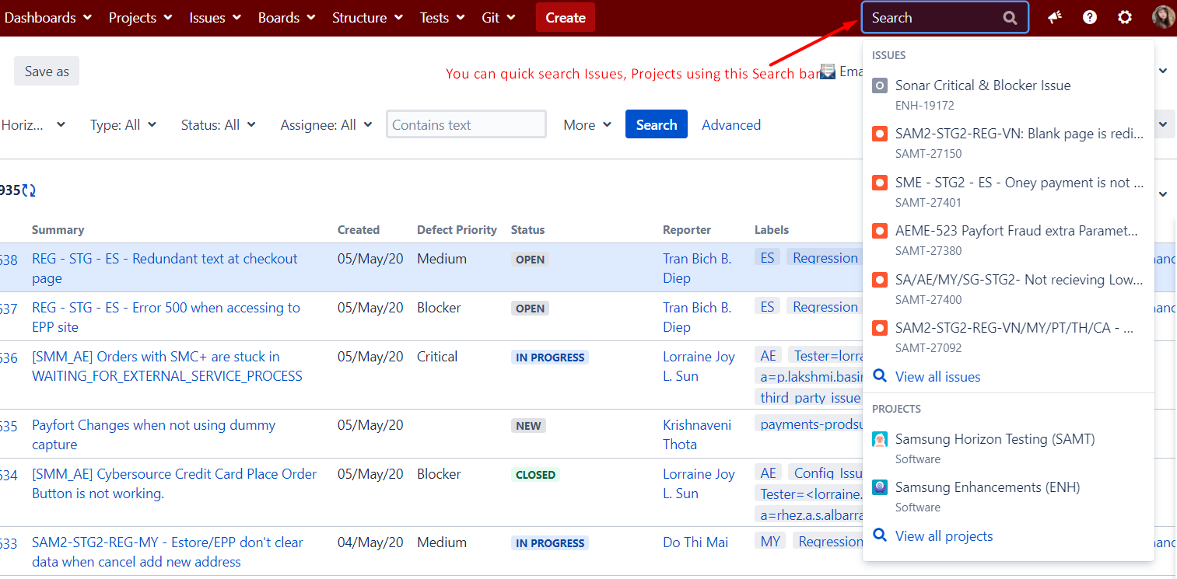
5.1. Search issue- Search bar

Slide 28
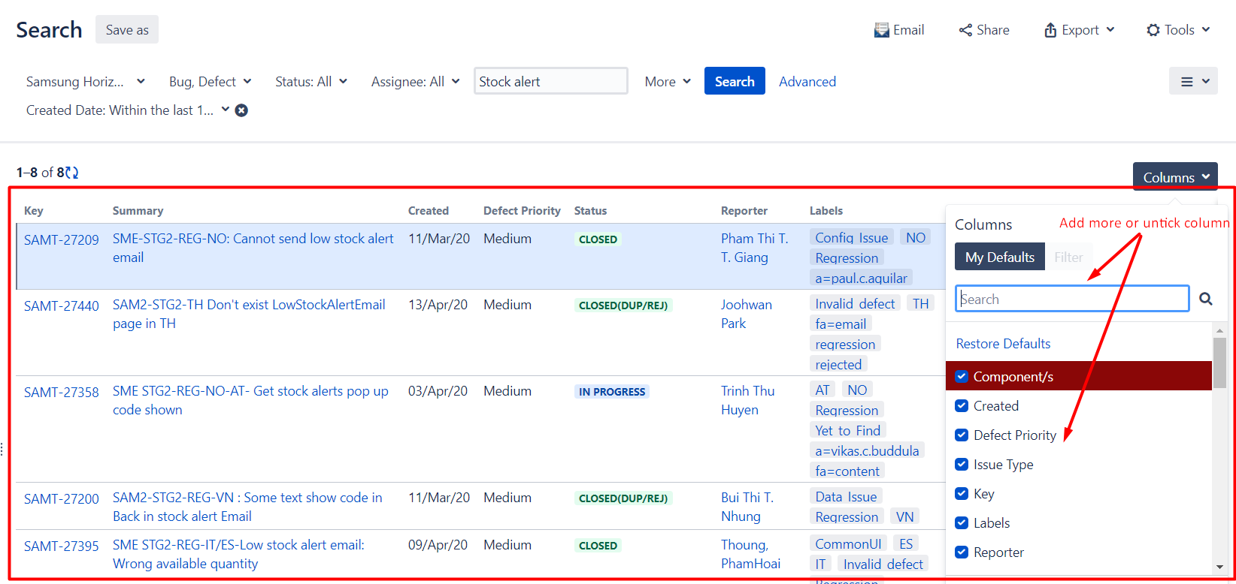
5.2. View issue list- Column

Slide 29
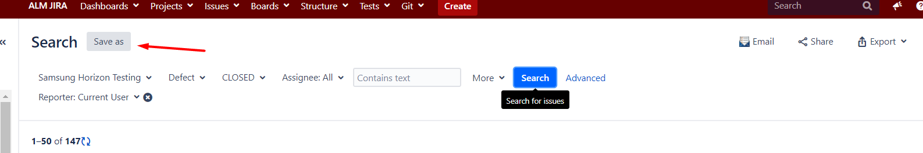
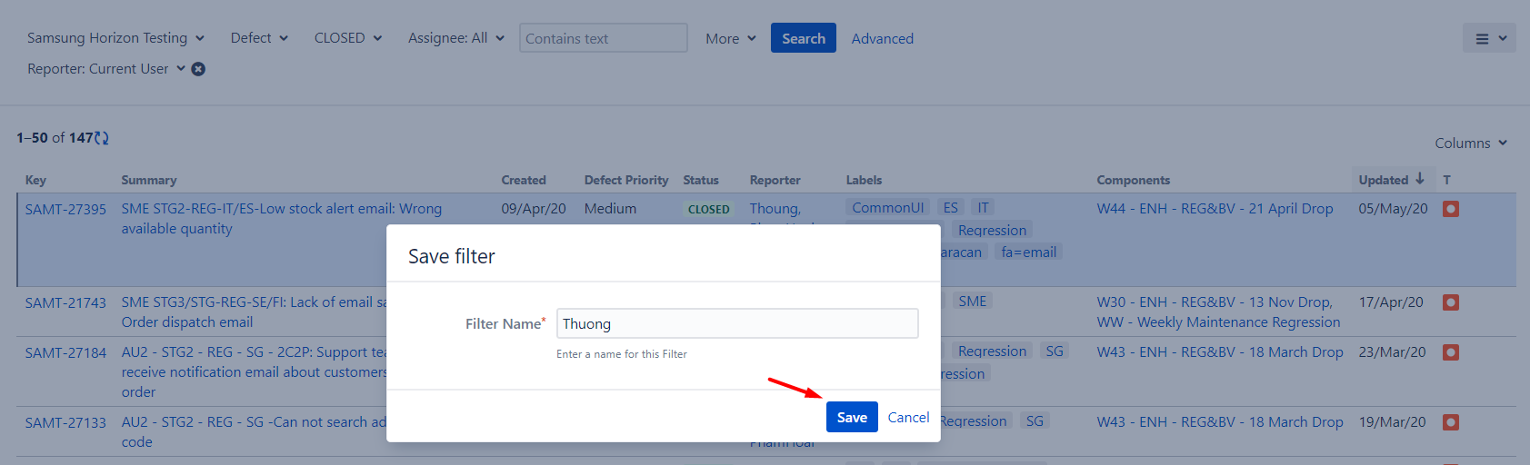
5.3. Filter- Create

Slide 30
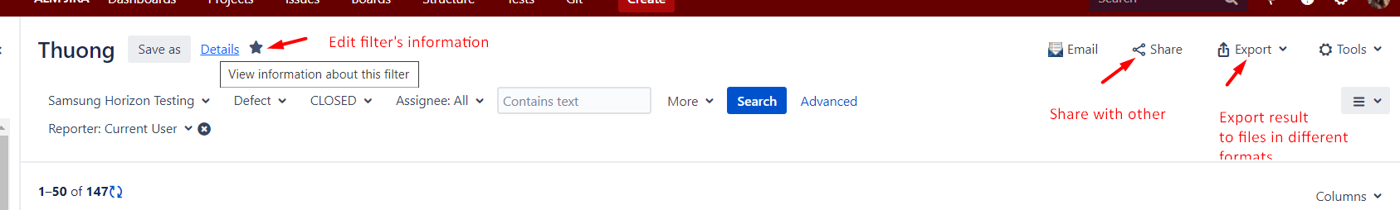
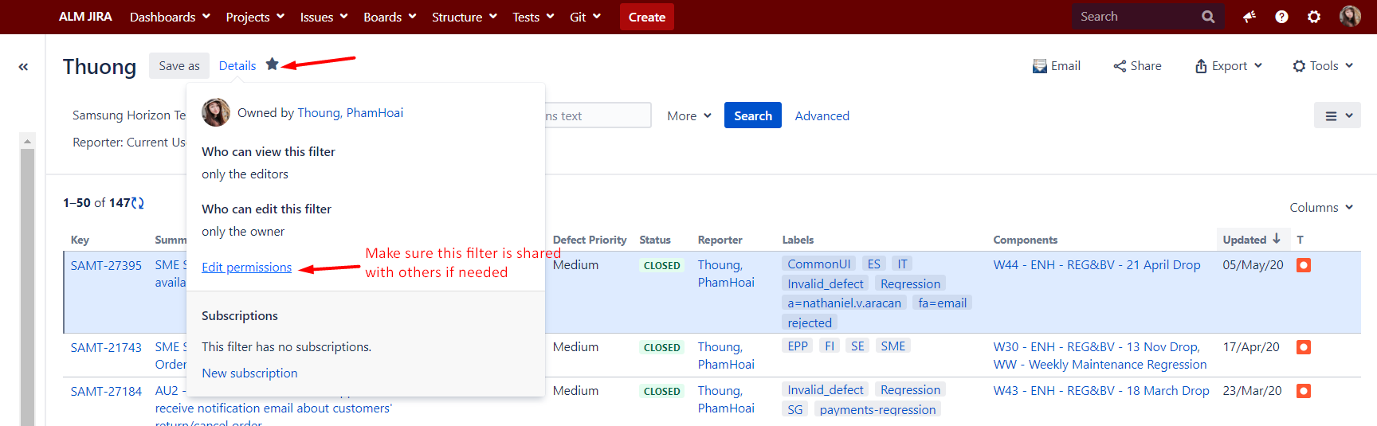
5.3. Filter- Create

Slide 31
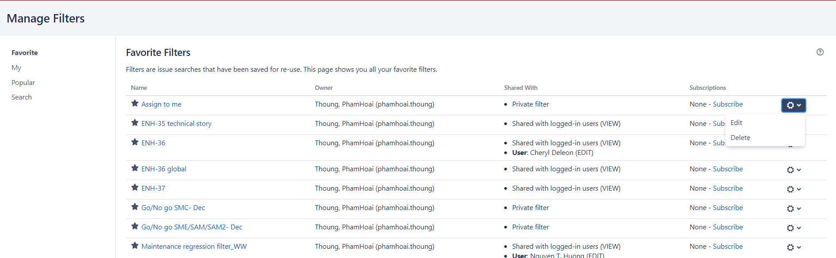
5.3. Filter- Manage

Slide 32
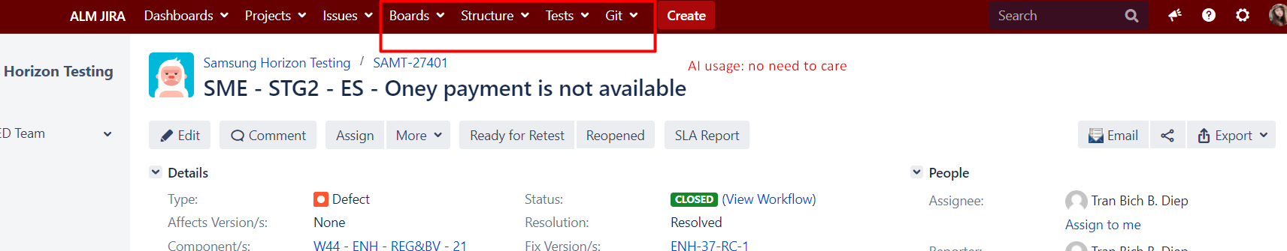
6. AI usage

Slide 33
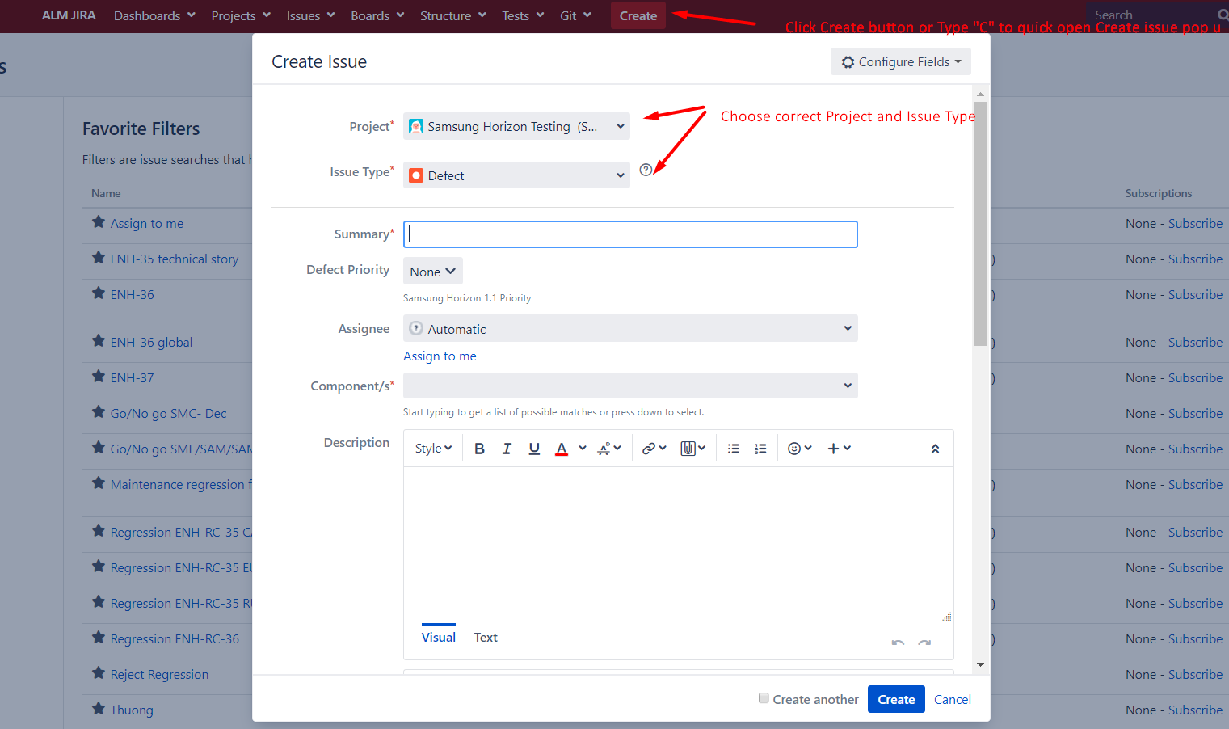
7. Create Defect
Clicking the “Create” button in the top navigation bar will open up a light box where you can create a new ticket for each issue type.

Slide 34
IV. Defect management

Slide 35
1. Create defect
Field | How to fill
Issue Type | Defect
Summary | Regression-Sever- Env-REG-Country code (Ex: Regression- SME/SAM-STG2/STG-NO/SE) Defect summary
Defect Priority | Blocker/Critical/Medium/Low
Assignee | Follow each Regression announcement
Component | Follow each Regression announcement
Description | Describe in next slide
Environment | Link test
Labels | Country code (2 characters. Ex: AU,NO,..)
Attachment | Image/video

Slide 36
1. Create defect
https://wisewiresglobal.atlassian.net/wiki/spaces/WG/pages/3671424/Regression+Defect+log+rule
Description- Sample:
[Precondition]
N/A
[Steps to reproduce]
1.Login to the SME STG Base store of DE
2.Click on any categories on Shop menu
3.Navigate to PLP
4. Select one specific category
[Actual results]
Nothing change on PLP
Refer to: (nếu có ảnh thì attach nó luôn vào đây ạ)
[Expected results]
PLP should be displayed according to category user are selecting.
[TCID] (optional)
MR_14_070
Test case ID là mã ở trong test case
[Deployment version]
From MS team notification (Ex: ENH.38.14)
[Browers]
IE/Iphone6-safari

Slide 37
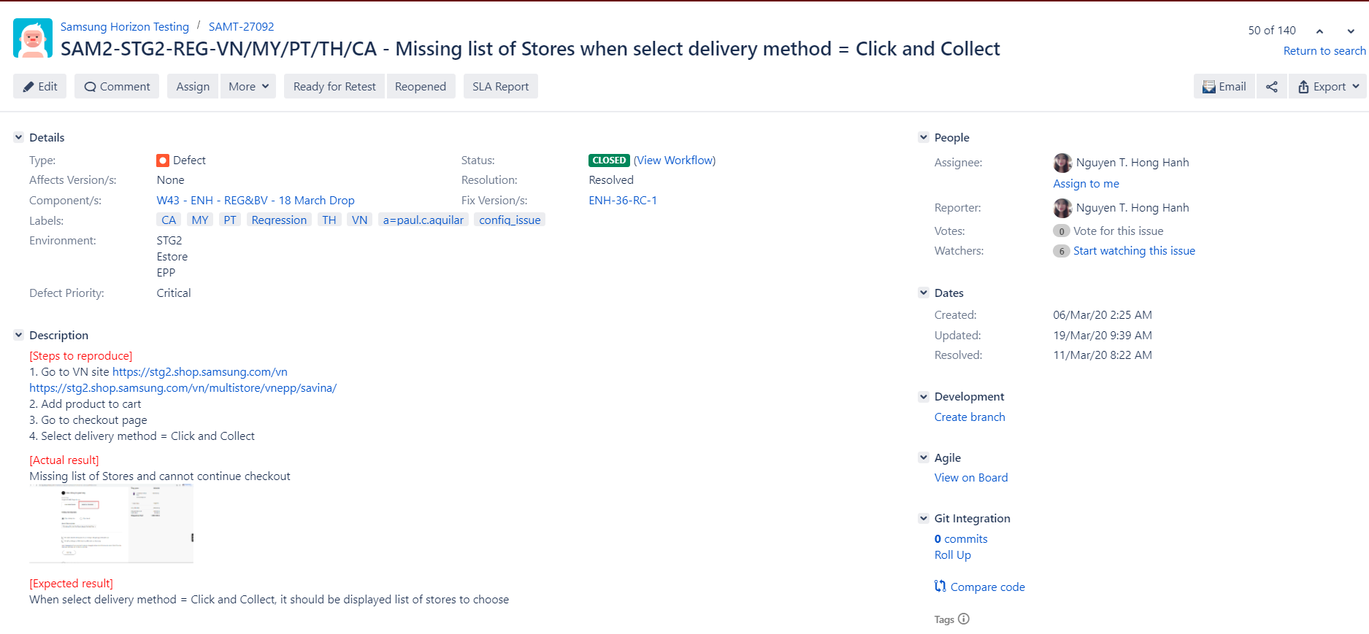
1. Create defect

Slide 38
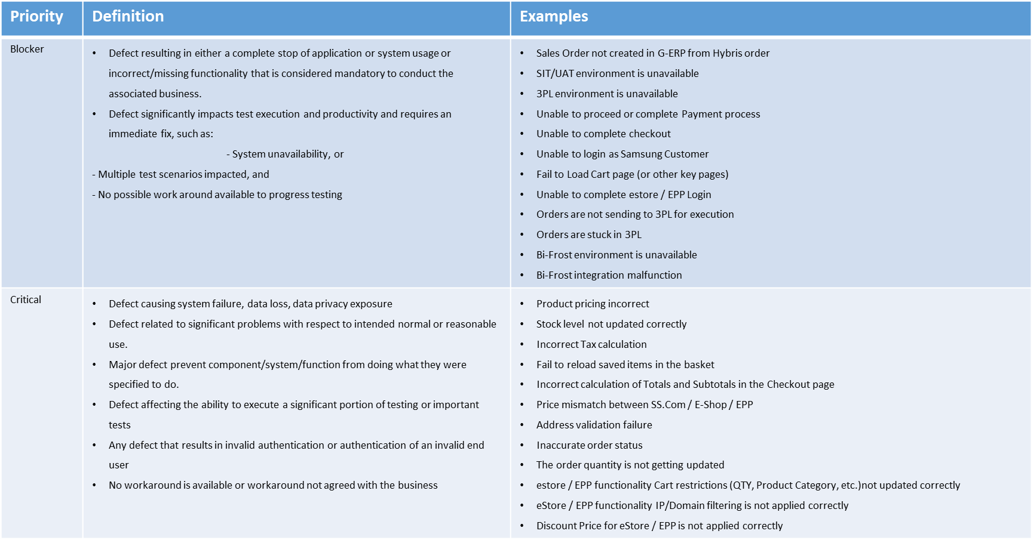
2. Defect’s severity evaluation

Slide 39
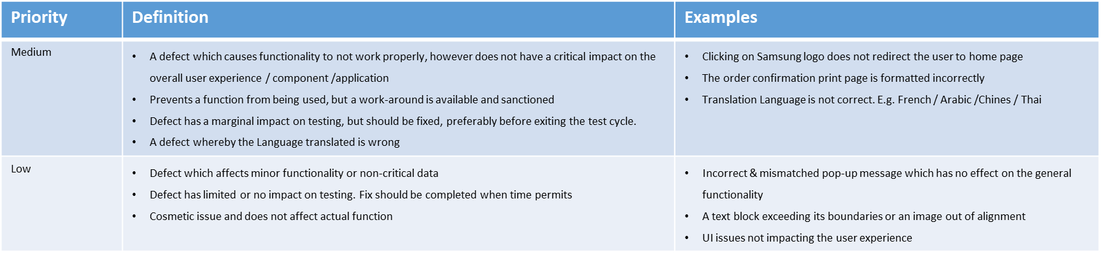
2. Defect’s severity evaluation

Slide 40
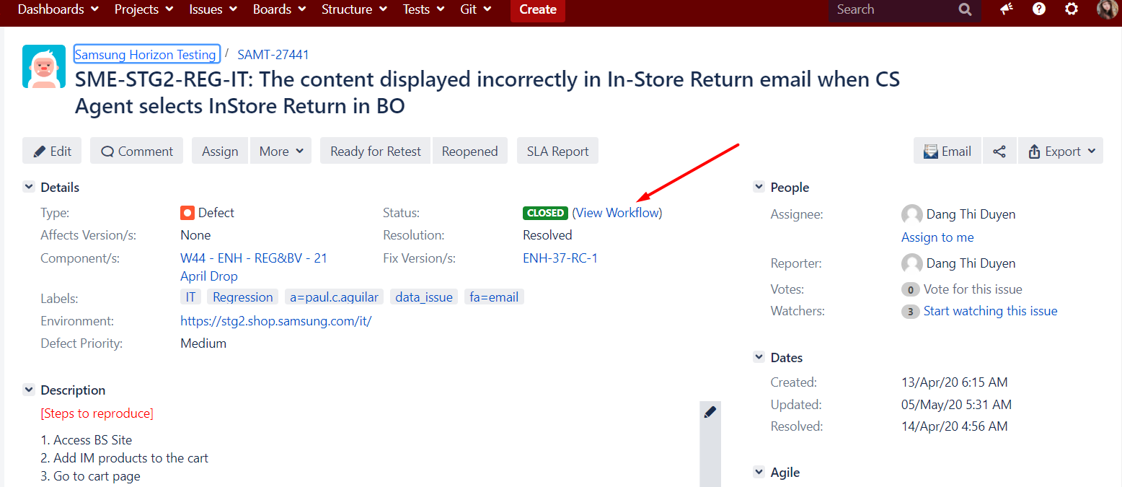
3. Workflow

Slide 41
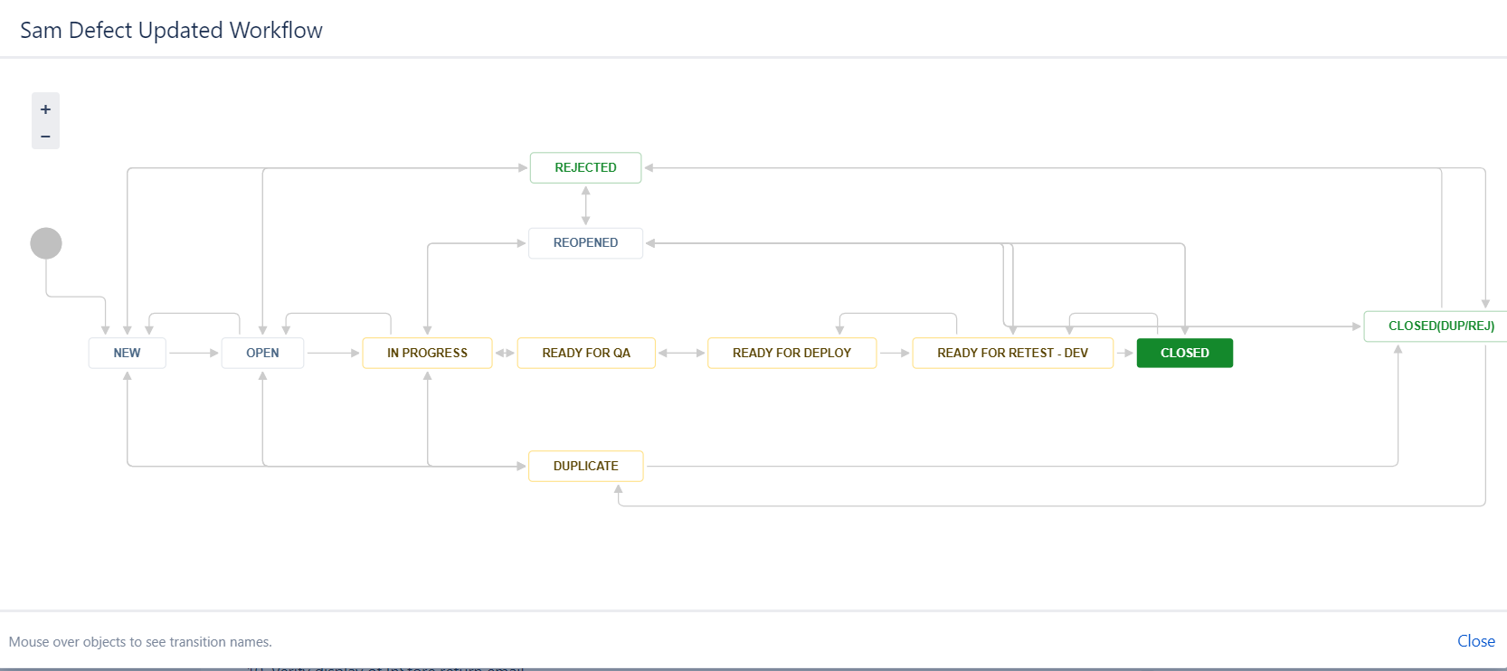
3. Workflow

Slide 42
3. Work flow
Please see below for a definition of each workflow status.
Status | Definition
New | This is a new ticket that has been submitted into Jira, but it hasn’t been looked into yet by anyone or any team. This status indicates that no progress has been made yet.
Open | Ticket is reviewed quickly by AI PIC, and assign to Dev to fix
In Progress | Dev is working on this ticket
Ready for QA | Ready for AI tester to test
Ready for Deploy | Ready to deploy to Staging environment
Ready for Retest | Ready for WW team to verify
Reopened | Defect is not fixed after retested
Closed | Ticket is fixed
Rejected | Ticket is rejected if It’s invalid or no code change needed
Duplicate | Ticket is duplicated with other tickets (may come from both AI and WW team)
Closed(Dup/Rej) | Ticket which are either duplicated or rejected is closed

Slide 43
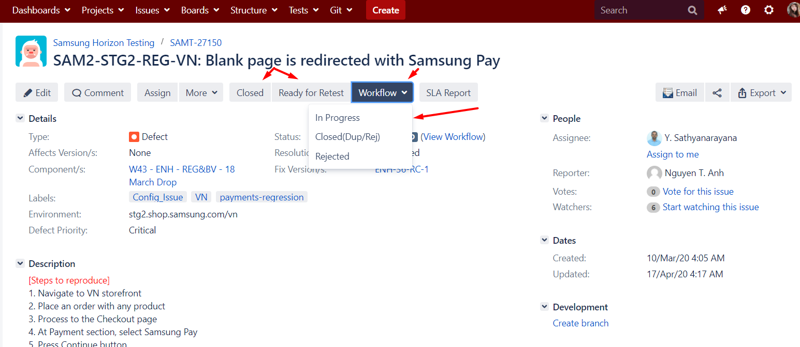
4. Change ticket status
Changing ticket’s status must follow workflow:
For example: To change ticket from Rejected to Closed, it must follow:
Rejected -> Open -> In progress -> Ready for QA -> Ready for Deploy -> Ready for retest -> Closed.

Slide 44
5. How to find Duplicate ticket
Ticket is considered as Duplicate if there is another same ticket logged by either AI or WW within recent 3 months.
Use basic filter
Project: SAMT,SAM,ENH,SAMR
Issue type: Defect,Bug
Put 1 word or synonym of that word in the textbox
For example:
Your defect is about: Stock alert pop up is not working properly.
You can put “Stock alert” in the text search field
Filter tickets that are created in recent 3 months

Slide 45
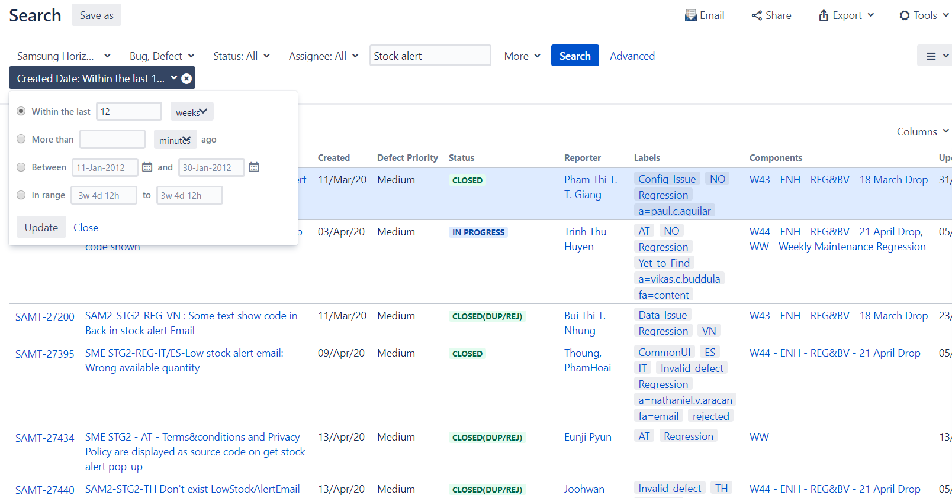
5. How to find Duplicate ticket

Slide 46
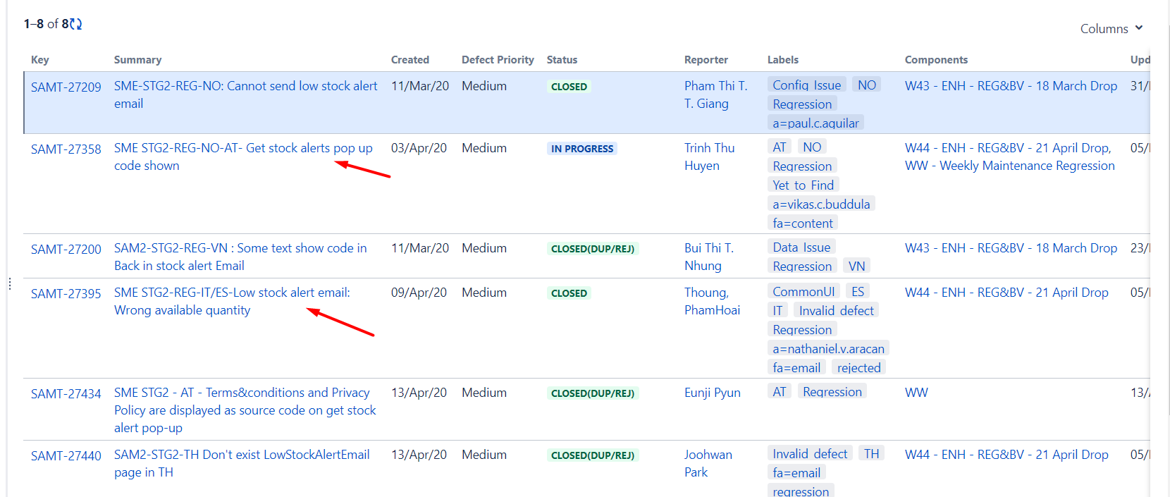
5. How to find Duplicate ticket
Scan all tickets found.
If ticket’s status is in Open, copy that ticket to our test result
If ticket’s status is in Closed, Reopen that ticket
If no duplicate ticket found, Create new ticket

Slide 47
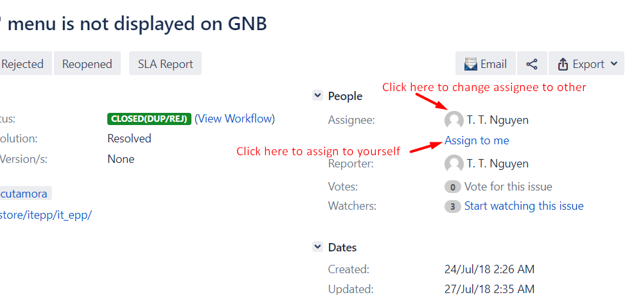
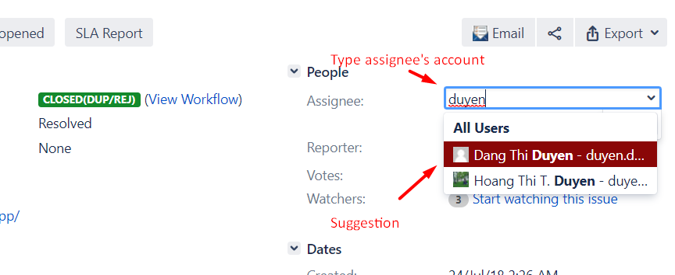
6. Change assignee

Slide 48
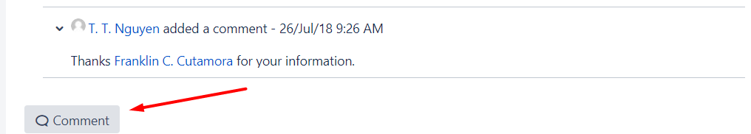
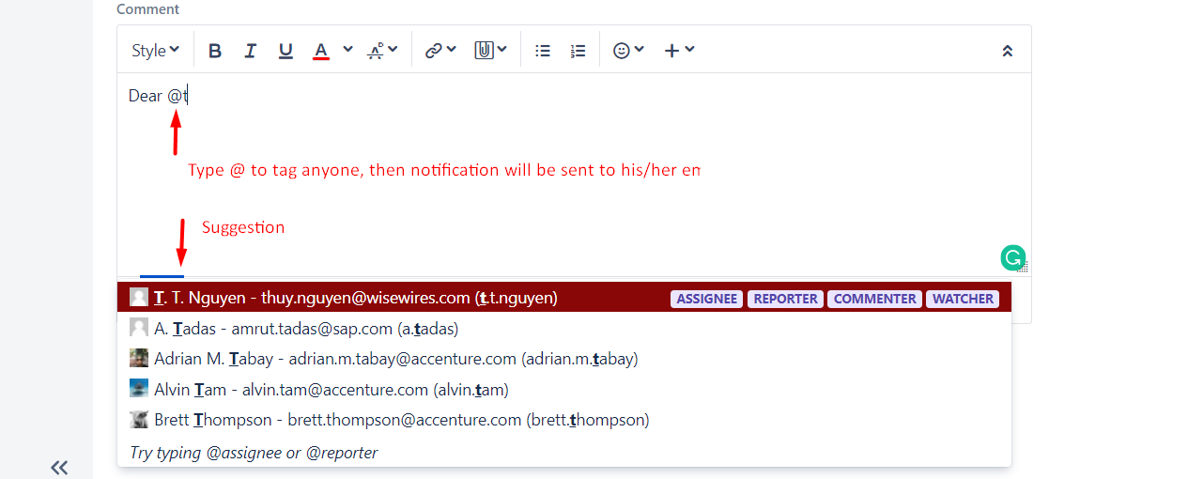
7. Add comment

Slide 49
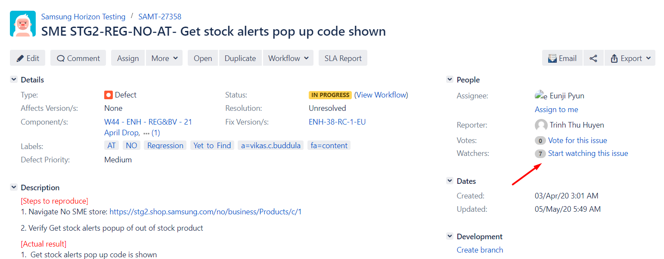
8. Add watcher
You can add yourself or other as ticket’s watcher to receive Jira notification to Email to keep track of ticket logged by other.

Slide 50
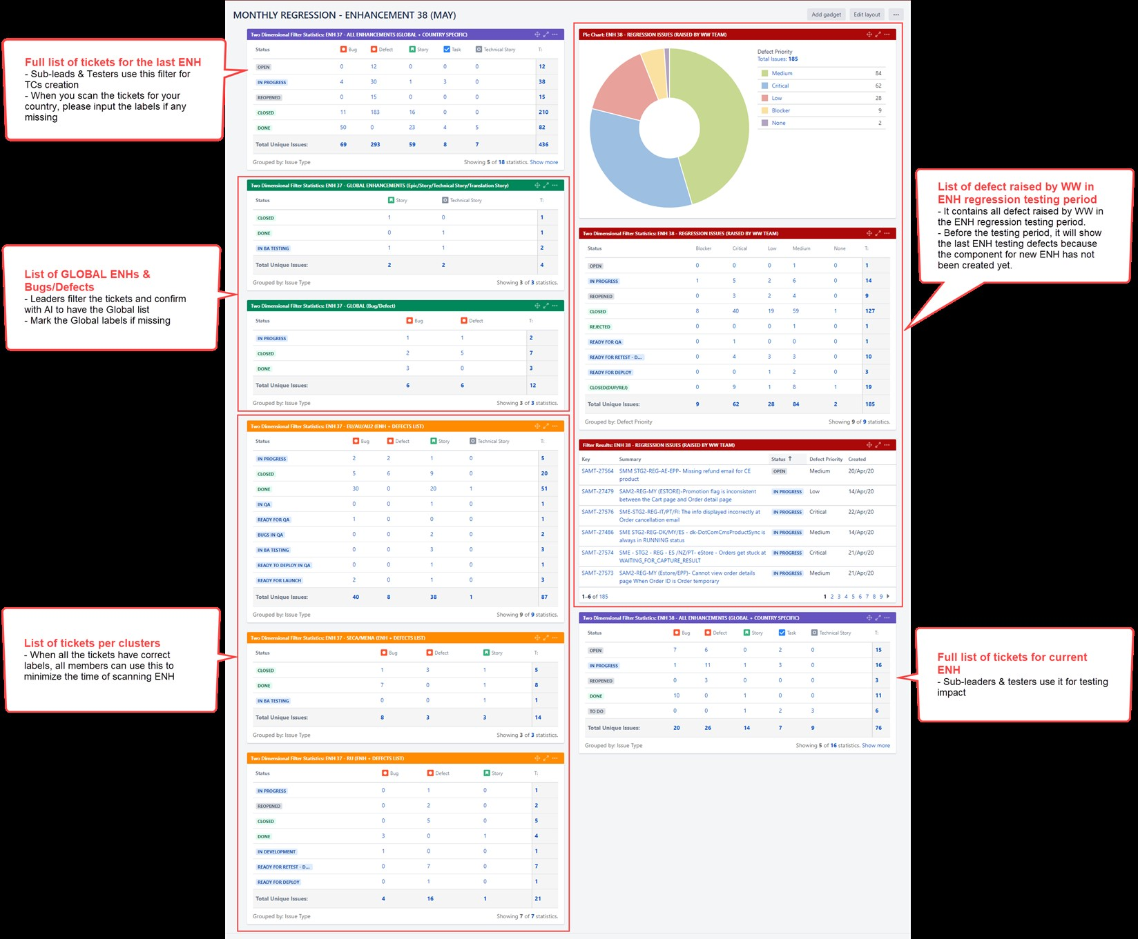
9. Monthly Dashboard

Slide 51
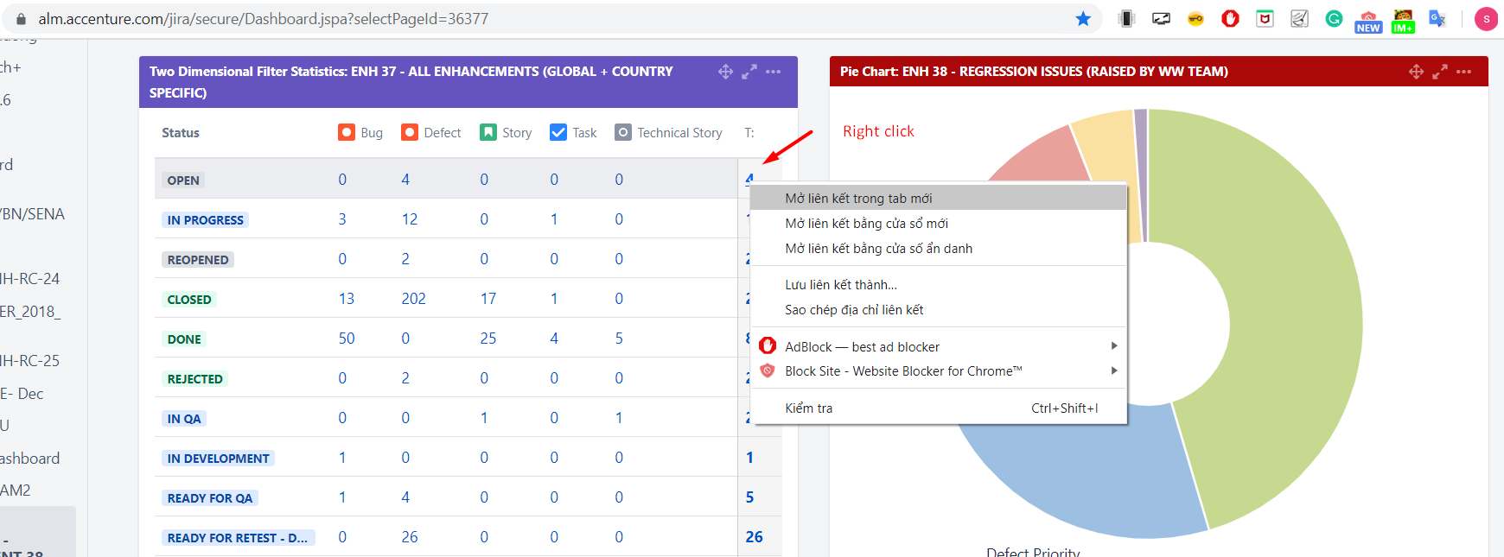
9. Monthly Dashboard
Link:https://alm.accenture.com/jira/secure/Dashboard.jspa?selectPageId=36377
To see any specific tickets list, just right click the total number to open

Slide 52
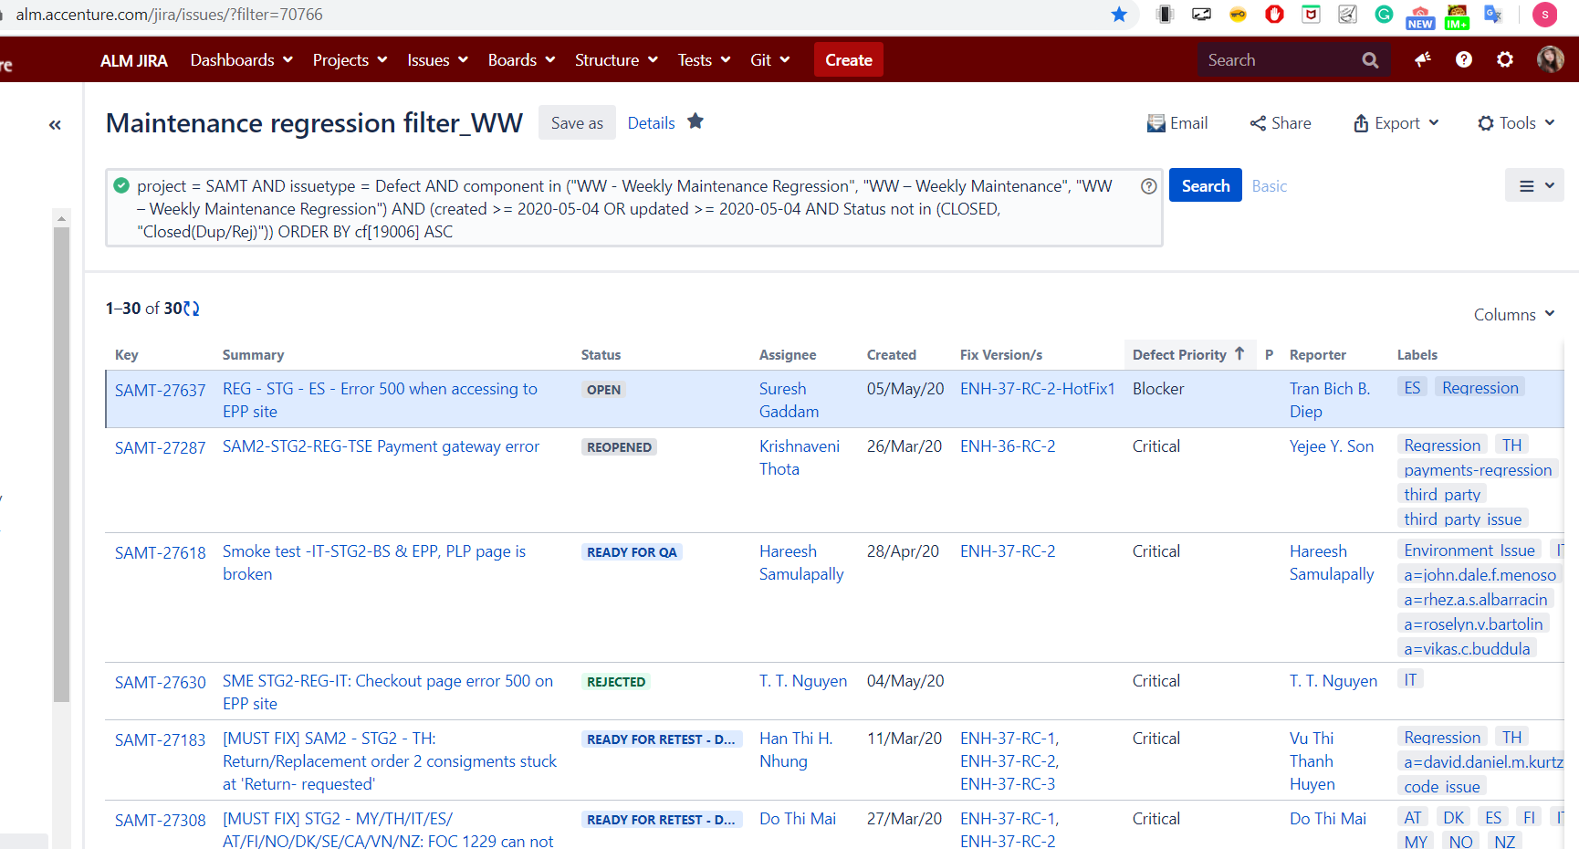
10. Maintenance filter
https://alm.accenture.com/jira/issues/?filter=70766

Slide 53


